Slide 1
Simple and Compound Microscope
Parts & Functions
Asst. Professor Chetan Singh

Slide 2
Simple Microscope - Overview
• A simple microscope uses a single convex lens for magnification.
• Functions like a magnifying glass.
• Magnifies objects up to 20x.
• Commonly used by watchmakers and jewelers.

Slide 3
Simple Microscope - Parts & Functions
• Lens: Magnifies the object.
• Handle: Helps to hold the microscope.
• Stage: Platform to place the object.
• Mirror (optional): Reflects light onto the object.

Slide 4
Compound Microscope - Overview
• Uses two or more lenses for higher magnification.
• Magnifies objects up to 1000x or more.
• Commonly used in labs to observe cells, bacteria, and microorganisms.

Slide 5
Compound Microscope - Parts & Functions
• Eyepiece: Lens you look through, usually 10x magnification.
• Objective Lenses: Provide main magnification (10x, 40x, 100x).
• Stage: Platform for placing slides.
• Light Source: Illuminates the specimen.
• Coarse Adjustment: Brings object into general focus.
• Fine Adjustment: Sharpens the focus.
• Arm: Supports the tube and connects it to the base.
• Base: Supports the microscope.

Slide 6
Comparison: Simple vs Compound Microscope
Simple Microscope:
• One lens
• Low magnification
• Easy to use and portable
Compound Microscope:
• Two or more lenses
• High magnification
• Used in scientific and medical research

Slide 7
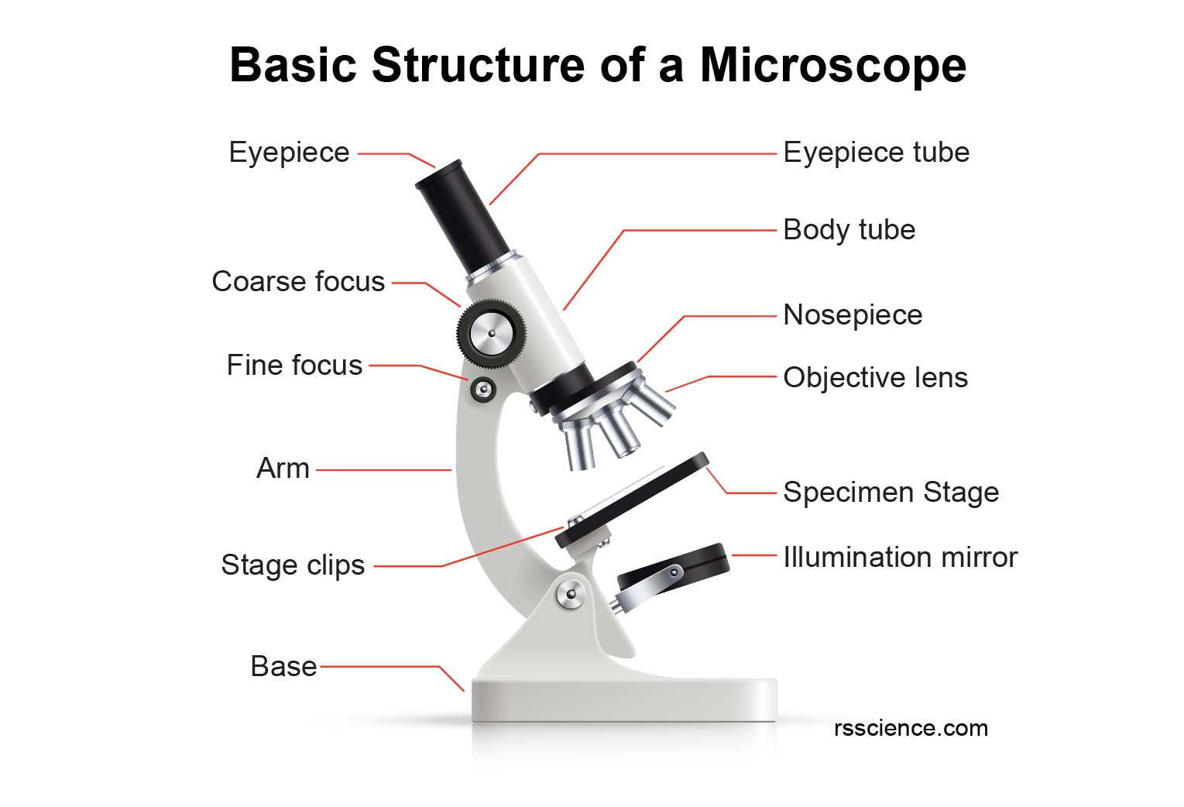

Slide 8
STEPS
The lowest power objective lens (for example, 4x) should be snapped into place by rotating the revolving turret/nosepiece.
Place the microscope slide on the stage and secure it using the stage clips.
Turn the focus knob to raise the stage as you look at the objective lens and stage from the side. Without letting the objective hit the coverslip, raise it as high as it will go.
Adjust the focus knob to focus the image while looking through the eyepiece.
Adjust the light’s brightness and the condenser’s position for the high amount of light.
When the sample is in the center of the field of vision, move the microscope slide.
For the clearest image, adjust the condenser and light intensity after focusing the sample using the focus knob.
You can switch to the next objective lenses once you obtain a clear image of your sample with the lowest power objective. The sample’s focus and/or the condenser and light intensity may need to be adjusted.
Make sure the objective lens doesn’t touch the slide!
After you’re done, lower the stage, click the low power lens into place, and then take out the slide

Slide 9
Medical Application(s):
Biology: Microscopes are essential for studying cells, tissues, and organisms. They are used to diagnose diseases, develop new drugs, and understand how life works.
Medicine: Microscopes can be used to diagnose diseases, such as cancer and infectious diseases. They are used to monitor the progress of treatment.

Slide 10
Thank You!

